Slide 1
Carter County Schools
The Standard of Excellence

Slide 2
Vision
Question Formulation Technique
Independent: Write as many questions concerning the picture as you can in your quadrant on the placemat. (60 Seconds)
Timed Round Robin beginning with number 1. (60 Seconds)
Consensus: Choose your top three questions and write in the center box.
Label your questions as opened and closed.
Turn your closed questions to open.
Prioritize your questions.

Slide 3
Vision
Research:
How does this picture exemplify the Standard of Excellence?
2. Extending:
How does your school exemplify the Standard of Excellence?
Choose two colors of Post It Notes.
Answer the two questions on different colors.
Create a T Chart on your school’s chart paper labeling one side PICTURE and one side SCHOOL.
Place Post It Notes on corresponding sides of the chart paper.

Slide 4
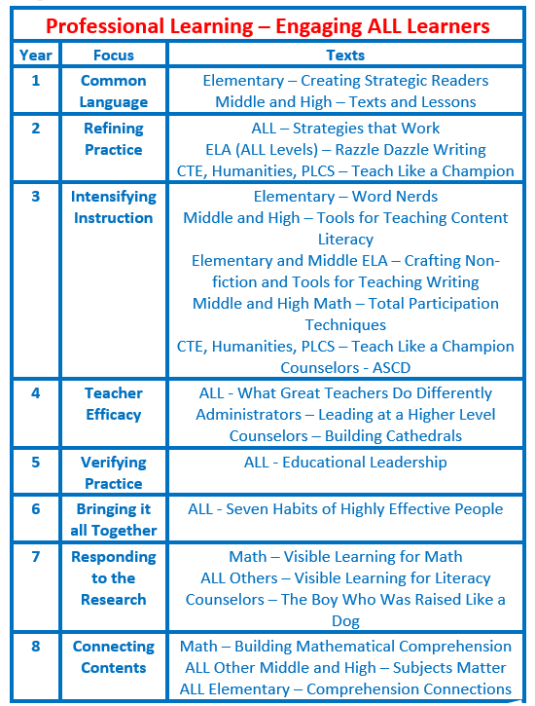
Connecting the Pieces
Professional Learning

Slide 5
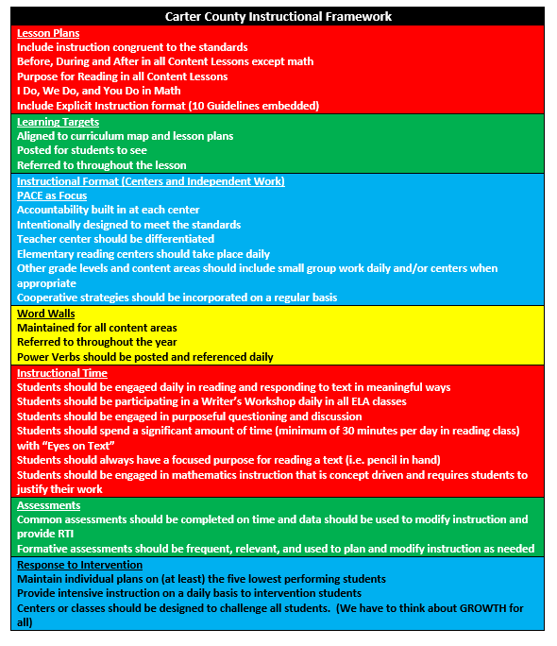
District/School Instructional Framework
Critical Piece
CLEAR EXPECTATIONS

Slide 6
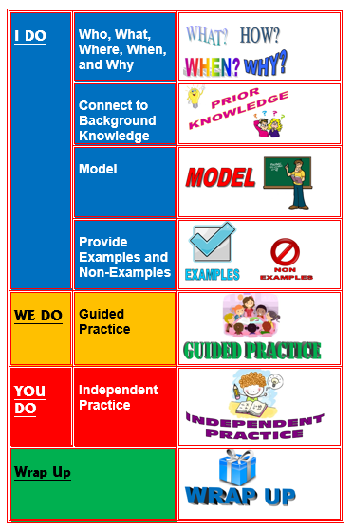
Critical Piece EXPLICIT INSTRUCTION

Slide 7
Critical Piece Instructional Planning

Slide 8
Critical Piece
BDA
BEFORE
DURING
AFTER

Slide 9
Critical Piece BEFORE, DURING, AND AFTER READING
WE SHOULDN’T STOP INSTRUCTION TO TEACH A READING STRATEGY.
RATHER STRATEGIES SHOULD BE THE METHOD IN WHICH WE TEACH OUR CONTENT.
THEY ARE A MEANS TO OUR OUTCOME OF SUCCESSFUL READERS IN ANY CONTENT.

Slide 10
Critical Piece PACE

Slide 11
Critical Piece Goal Setting
Student Goal Setting Process
Students are given a pre-assessment.
Students develop goals for the common/benchmark assessment.
Students input activities that will help them meet their goals.
Teachers monitor progress during each unit.
Students repeat the process for each unit.

Slide 12
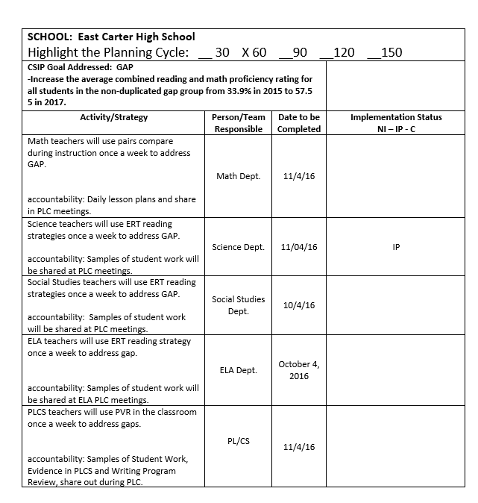
Structure 12 30-60-90 Day Planning
Critical Piece

Slide 13
Critical Piece PLC Process
PLC Process Focus
DO WE
Understand standards and targets?
Share effective strategies to teach the standards?
Assess and analyze data?
Identify students who are not meeting standards?
Develop a plan of action for improvement?

Slide 14
Critical Piece
PDSA

Slide 15
Quizlet Live

Slide 16
Close Reading PACE
1st Read(Key Ideas and Details)
P--Read closely to determine what the text says explicitly.
A--Annotate the text and answer questions, Timed Pair Share
C-RI 7.1
E--Independently Read "The Power of Collective Efficacy"

Slide 17
Close Reading PACE
2nd Read(Craft and Structure)
P--Read closely to interpret words and phrases as they are used in a text.
A--Take notes in the left margin, answer questions, Timed Pair Share
C-RI 7. 4
E--Independently Read "The Power of Collective Efficacy"

Slide 18
Close Reading PACE
3rd Read(Integration of Knowledge and Ideas)
P--Read closely to analyze how a text addresses a theme.
A--Take notes in the right margin, constructed response question, Timed Pair Share
C-RI 7. 9 (scaffolding)
E--Independently Read "The Power of Collective Efficacy"

Slide 19
PACE

Slide 21
Critical Piece
Teacher Guide
Strategy Review
Teacher Guide

Slide 22
Day 2

Slide 23
Established expectations for administrators by Superintendent
Be the Instructional Leader in your school
Be a problem solver not an excuse finder
Know the assessment results of your school
Know the PD needs of your school and plan accordingly
Seek out opportunities for professional growth for yourself and the teachers you supervise
Support district initiatives for school improvement
Treat everyone fairly and with respect
Professional courtesy to colleague

